Slide 1


Native Driver Application Solutions
By Richard Jiang
The future is present -----Mobile Team

Slide 2


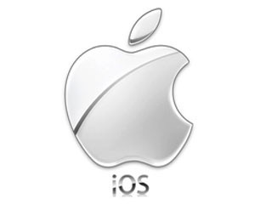

What is the future?
Native App
Hybird App
Native Driver

Slide 3

What is the native driver application?

Slide 4
What is the react-native?
It is not canvas by webkit.
It is not compile by byte data.
It is native api driver application.
It will be popular on mobile platform.(IOS And Android)

Slide 5
What is the react-native?
Install react-native-cli:
Test react-native command:

Slide 6
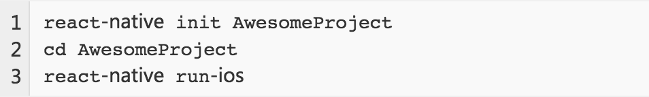
Create React-Native Project
Note: Above command will create one demo project for react-native and start emulator.

Slide 7
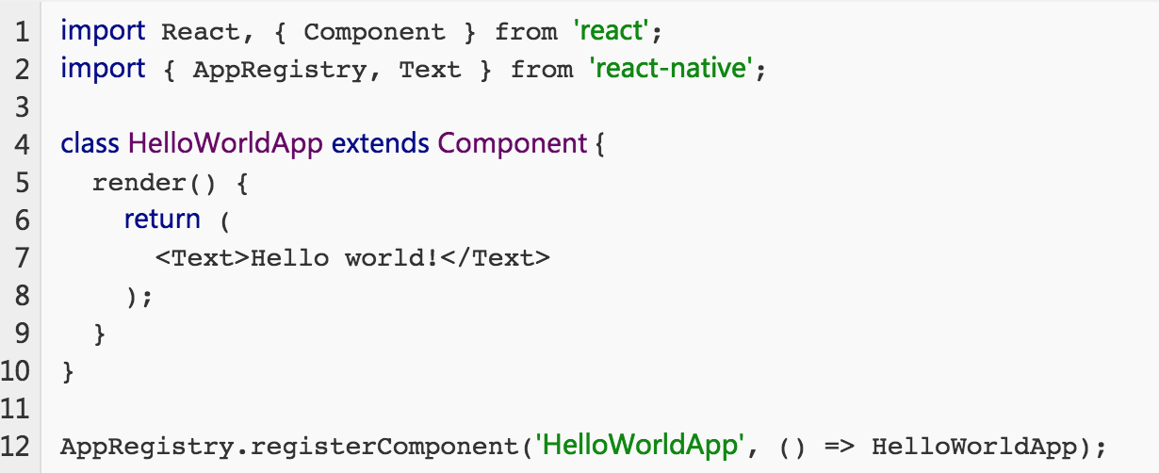
Simple Code For React.

Slide 8
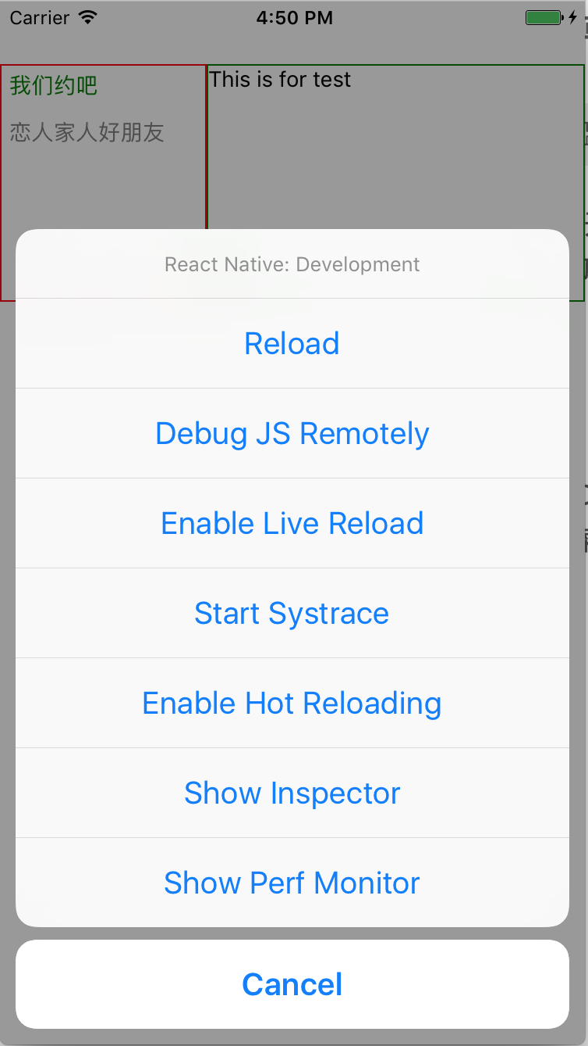
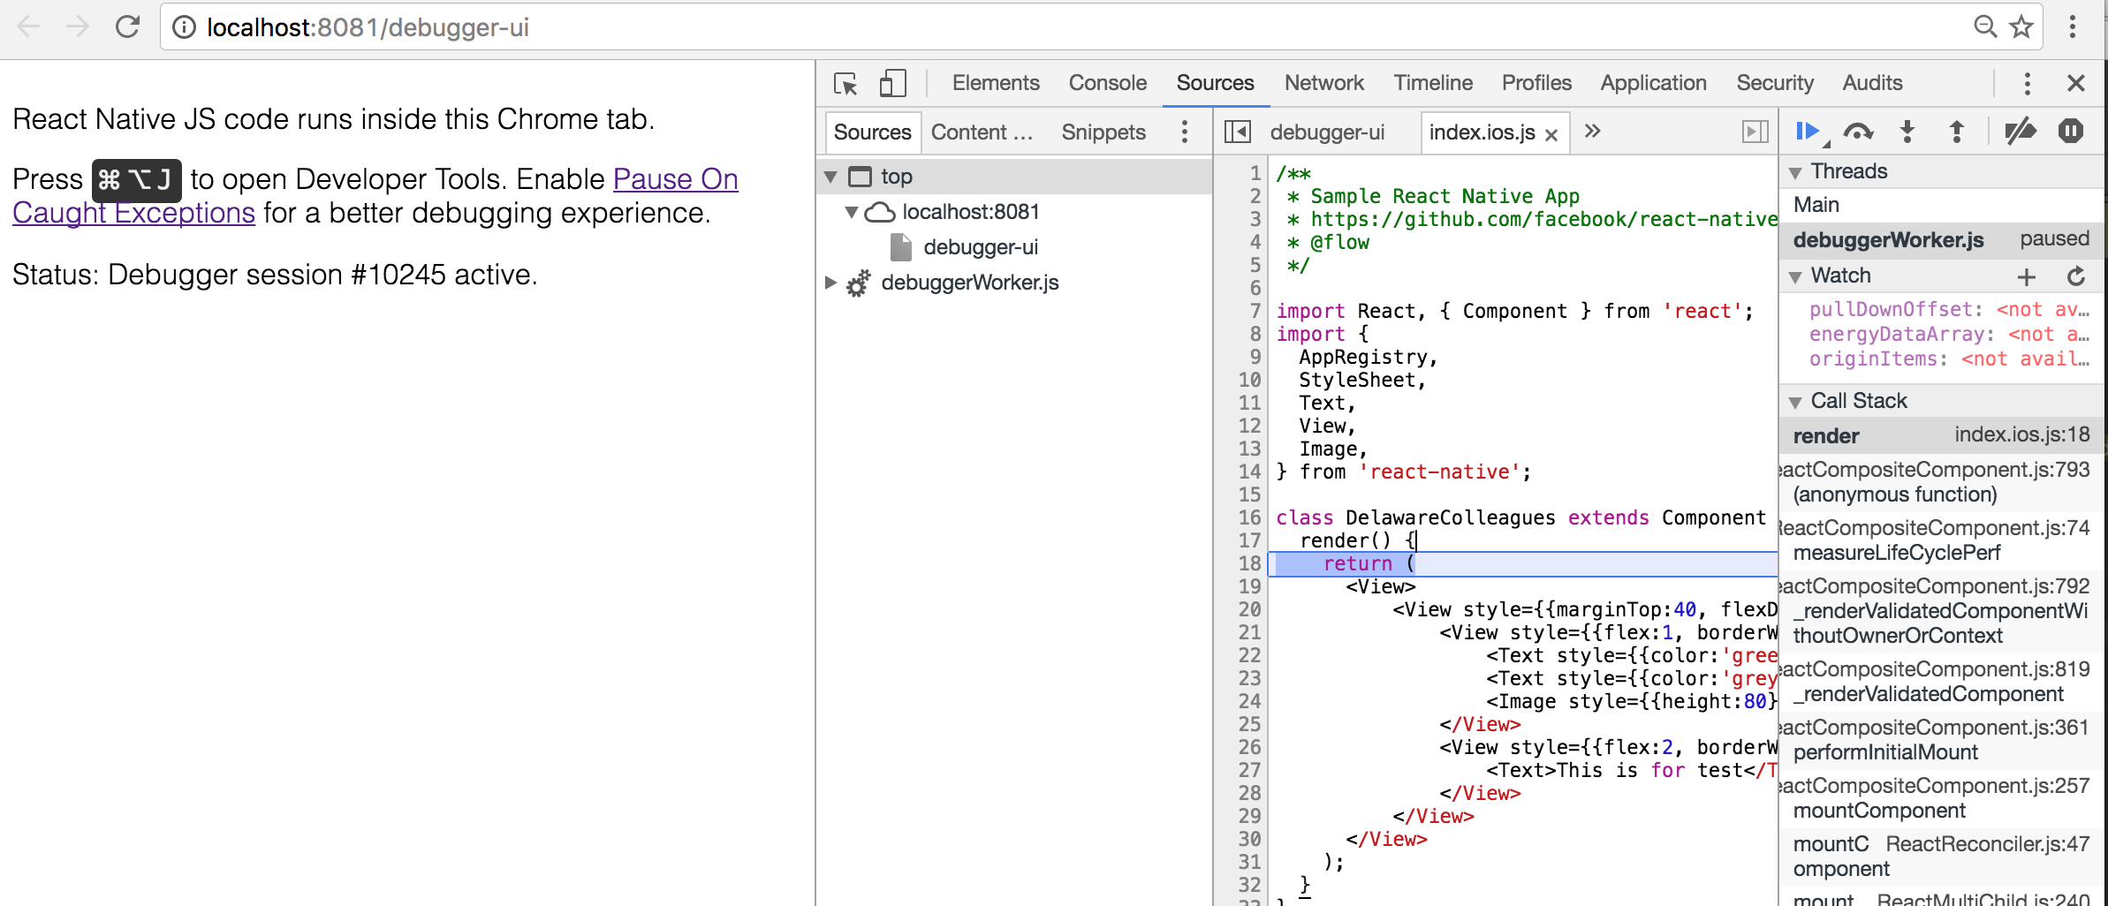
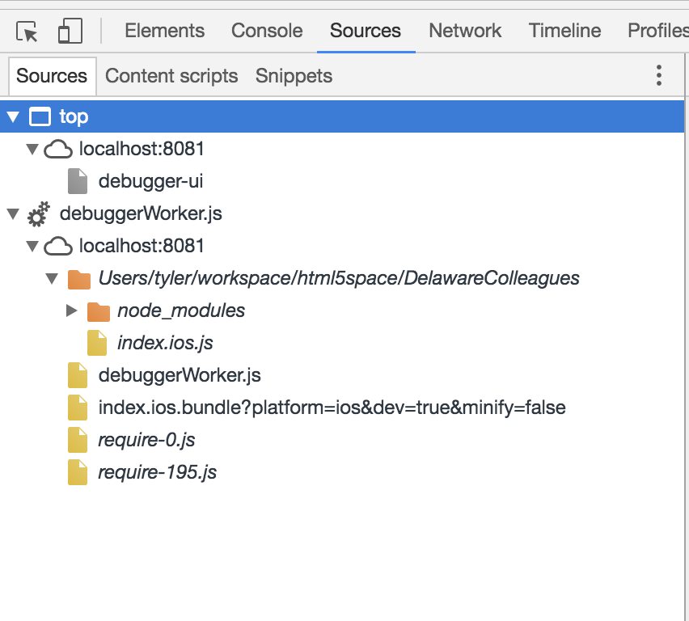
Debug React-Native Project
cmd+D && command+option+J

Slide 9
Some Components For React-Native
DatePickerIOS
PickerIOS
ListView
…
NavigatorIOS
ProgressViewIOS
Text
…
TabBarIOS
Slider
Alert
…
Switch
ActivityIndicator
Image
…
TextInput
ScrollView
View
…

Slide 10
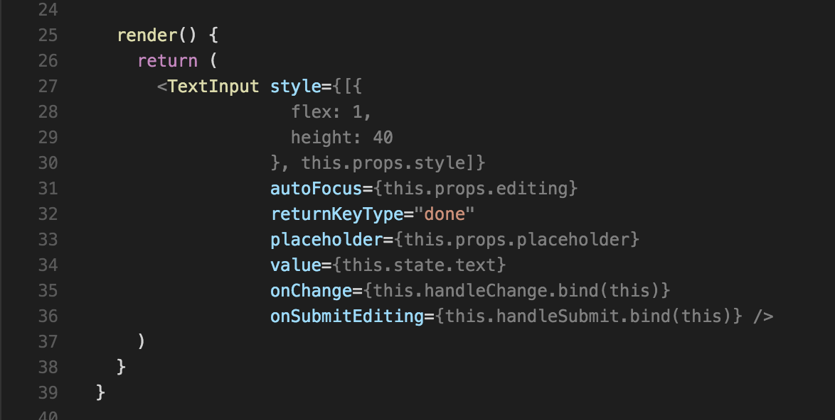
How to use components?

Slide 11
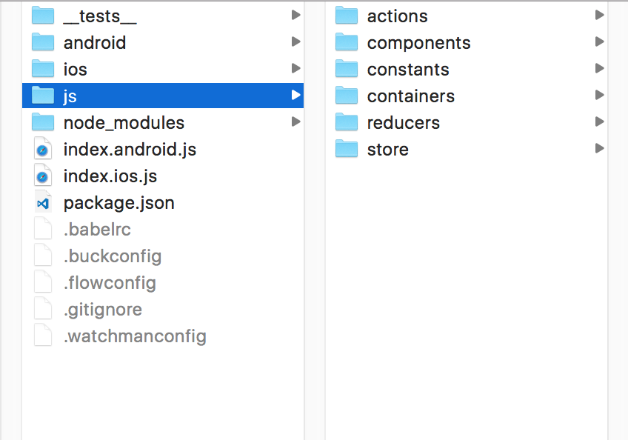
Debug React-Native Project
The root file for react-native project
The project file for platforms
(Android & IOS)

Slide 12
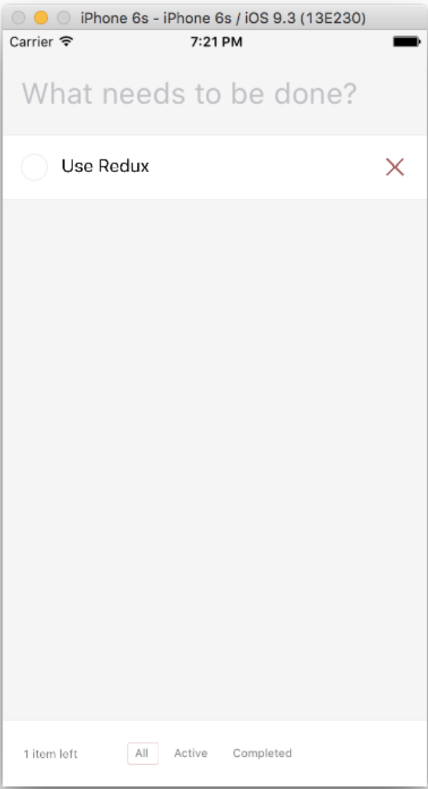
Demo Project

Slide 13


